Slide 1
Evaluation of RC building strengthened with column jacketing method with consideration of soft-story
Hendrik Wijaya
Department of Civil and Construction Engineering, Swinburne University of Technology, Melbourne, Australia.

Slide 2
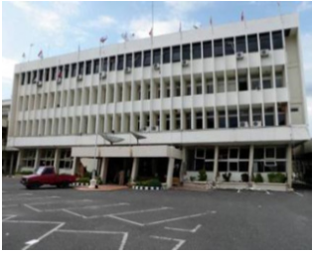
Introduction
Soft-story failure mechanism occurred due to seismic excitation as reported in Indonesia.
                Padang (2007)
The soft-story mechanism occurs when the stiffness of one story is much less than the adjacent story stiffness.
The structure with higher soft-story level was found to be more vulnerable in moderate to high intensity earthquake.

Slide 3
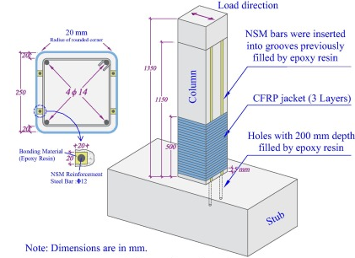
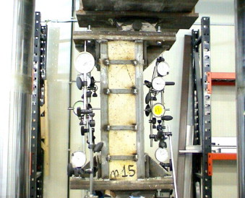
Soft-Story Column-Jacketing Retrofitting Method
FRP + NSM composite
[11]
Steel Jacketing
[9]

Slide 4
Case Study
Column
Beam
450
500
4@3500
450
250
Details:
Stirrups ϕ10-150
Column 8ϕ19
Beam 3ϕ16 (Top & Bottom)
L₁
3@5000

Slide 5
Impact of Soft-Story
The soft-story is quantified by story lateral stiffness, therefore the parameter of soft-story used in this paper is the relative height between the first-story column and the adjacent floors column height.
Where K₁ and K₂ are the lateral stiffness of first and second story while L₁ and L₂ defines the column height of the first and second story respectively

Slide 6
Impact of Soft-Story

Slide 7
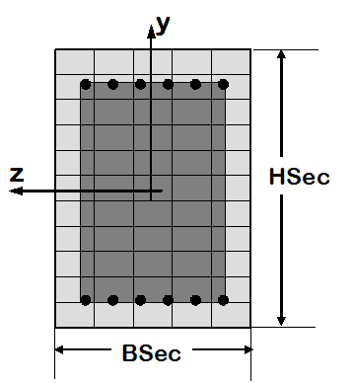
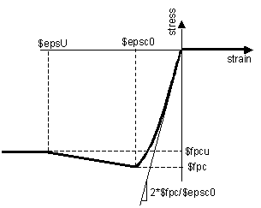
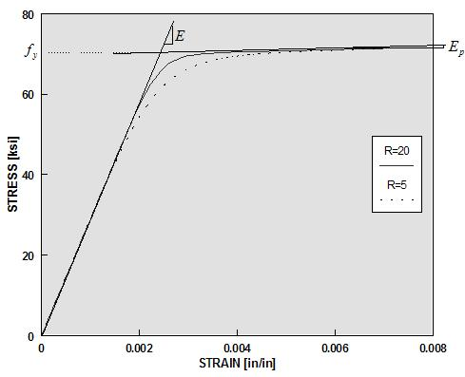
Finite Element Model
Reinforced Concrete Section
The building model is constructed in OpenSees finite element software
Concrete01
Steel02
Giuffre-Menegotto-Pinto

Slide 8
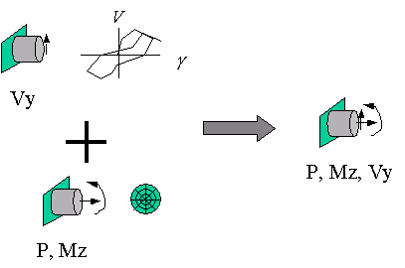
Finite Element Model
Reinforced Concrete Section
Section aggregator is used to model the shear-axial and flexural response.
Sezen [13] shear-deformation model is used in this study

Slide 9
Finite Element Model
FRP Jacketing
The base-column is strengthened with 3 layers of MasterBrace FIB 450/50 Carbon Fibre Sheet with fabric thickness of 0.255 mm, fabric width of 500 mm, tensile strength of 4900 MPa and 230 GPa tensile elastic modulus with near surface-mounted (NSM) system of 13 mm diameter reinforcement bar.
ConfinedConcrete01
ReinforcingSteel

Slide 10
Finite Element Model
FRP Jacketing

Slide 11
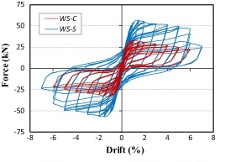
Finite Element Model
FRP Jacketing
Experimental cyclic loading result comparison
[11]

Slide 12
Finite Element Model
Steel Jacketing
The steel jacketing technique used in this study is based on the work of Rosario Montouri and Vincenzo Piluso [9].
The column is strengthened with angles and battens to increase the stiffness and confinement. Angle size of 150.150.12 is used with batten width and thickness of 15mm and 3mm respectively with 250 MPa yield strength applied 0.5 m from the column end

Slide 13
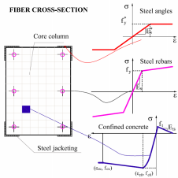
Finite Element Model
Steel Jacketing
The physical model approach used in this study was proposed by Campione et al. [1]. The angles properties were modified from the work of by defining the interface and contact between the steel angles and reinforced concrete column.

Slide 14
Earthquake Ground Motions
Four set of ground motion records are selected and matched with target response spectrum of Banda Aceh earthquake with site class D. The records include Kobe, Loma Petra, Tabas and Managua records.
Matched and target response spectrum

Slide 15
Result and Discussion
Maximum Inter-story Drift

Slide 16
Maximum drift for Kobe
Maximum drift for Loma Petra
Maximum drift for Managua
Maximum drift for Tabas

Slide 17
Result and Discussion
Lateral Capacity

Slide 18
SS1
SS2
SS3
SS4

Slide 19
Conclusion
The soft-story affect the lateral capacity of the reinforced concrete building. It is observed that the increasing height of the first story results in decreasing peak value of base shear in pushover curve for all building models.
Base column strengthened with FRP and near mounted surface system is noticed not efficient in strengthening the structure. More numbers of NSM bars and layers of CFRP may be required for the strengthening method to be applicable. Furthermore, providing the FRP jacket not only at the base column may also be considered.
Steel jacketing techniques shows efficiency in increasing structure lateral stiffness and decreasing the nonlinear response under earthquake excitation.
Effectiveness of strengthened column varies under different ground motions. It is recommended to perform reliability analysis for future research.

Slide 20
References
Campione G, Cavaleri L, Di Trapani F, Ferrotto M F, Macaluso G, & Papia M (2015) Modelling steel jacketed RC columns: Remarks by experimental-numerical comparisons In OpenSees Days, 2nd Italian Conference (pp. 10-11).
FEMA 440 (2005) Improvement of nonlinear static seismic analysis procedures FEMA-440, Redwood City.
Franchin P, A O L O, & Pinto P E (2007, April) Transitability of mainshock-damaged bridges In Proc. 1st joint US Italy workshop on seismic design of bridges Pavia, Italy: IUSSPress.
Furtado A, Rodrigues H, Varum H, & Costa A (2017) Evaluation of different strengthening techniques’ efficiency for a soft storey building European Journal of Environmental and Civil Engineering, 21(4), 371-388.
Garcia R, Hajirasouliha I, & Pilakoutas K (2010) Seismic behaviour of deficient RC frames strengthened with CFRP composites Engineering Structures, 32(10), 3075-3085.
Ghobarah A, Saatcioglu M, & Nistor I (2006) The impact of the 26 December 2004 earthquake and tsunami on structures and infrastructure Engineering structures, 28(2), 312-326.
Mander J B, Priestley M J, & Park R (1988) Theoretical stress-strain model for confined concrete Journal of structural engineering, 114(8), 1804-1826.
McKenna F, Fenves G L, & Scott M H (2000) Open system for earthquake engineering simulation University of California, Berkeley, CA.
Montuori R, & Piluso V (2009) Reinforced concrete columns strengthened with angles and battens subjected to eccentric load Engineering Structures, 31(2), 539-550.
Rajeev P, & Tesfamariam S (2012) Seismic fragilities for reinforced concrete buildings with consideration of irregularities Structural Safety, 39, 1-13.
Seifi A, Hosseini A, Marefat M S, & Zareian M S (2017) Improving seismic performance of old-type RC frames using NSM technique and FRP jackets Engineering Structures, 147, 705-723.
SNI-1726 (2012) Indonesian seismic code for Buildings and other structures.
Sezen, H. (2008). Shear deformation model for reinforced concrete columns. Structural Engineering and Mechanics, 28(1), 39-52.

Slide 21
Thank You

